Slide 1
Social Media Training
By Robin Whitmore and Duey (Teen Partner)

Slide 2
What are different types of Social Media?
Social Networking Sites
Social Review Sites
Image Sharing Sites
Video Hosting Sites
Community Blogs

Slide 3
Social Networking Sites
Ability to connect with friends, family, share thoughts and give feedback.
Facebook
Twitter
LinkedIn – professional connection
Google+

Slide 4
Social Review Sites
You need it; Social Review Sites Help you find,
And Compare.
Yelp
Trip Advisor

Slide 5
Image Sharing Sites
This Photo by Unknown Author is licensed under CC BY-NC-ND
Allows the ability to share: Visual Content, Pictures, Graphics
Instagram
Snapchat
Pinterest – Pin platform. Digital Media.
This Photo by Unknown Author is licensed under CC BY-NC
This Photo by Unknown Author is licensed under CC BY-NC-ND

Slide 6
Video Hosting Sites
Ability to post videos and give feedback.
YouTube
Vimeo
Tic Tok
flickr
This Photo by Unknown Author is licensed under CC BY
This Photo by Unknown Author is licensed under CC BY-SA-NC
This Photo by Unknown Author is licensed under CC BY-NC-ND
This Photo by Unknown Author is licensed under CC BY-SA

Slide 7
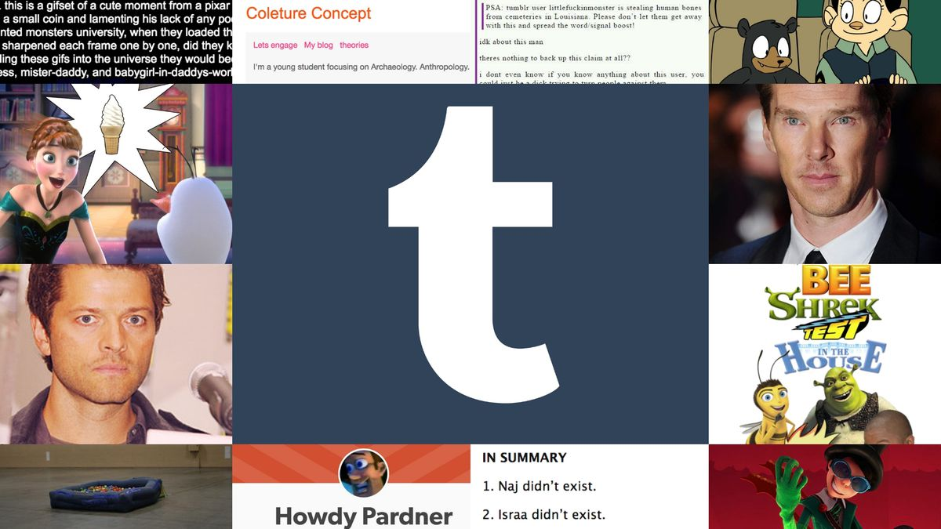
Community Blogs
Share thoughts and connect to readers
Medium
Tumblr – includes strict guidelines

Slide 8
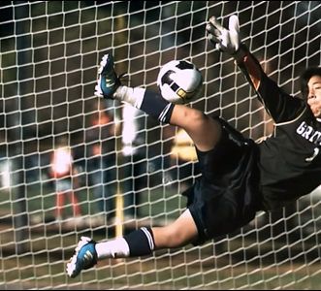
What are the potential dangers of Social Media?
Daniel Cui’s story of Facebook Bullying
Play below video:
https://www.youtube.com/watch?v=WJNrNVpyzSE

Slide 9
Ways to prevent Cyberbullying
Think before you post
Read through what you have written
If it could make someone sad or angry, Don’t post
Called ReThink – developed by 14-year-old Trisha Prabhu
This Photo by Unknown Author is licensed under CC BY-SA

Slide 10
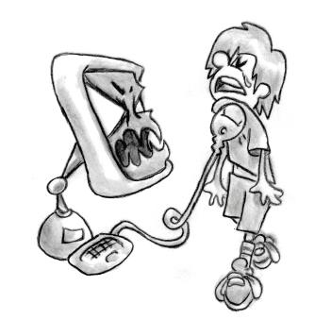
What do you do if you are Cyberbullied?
Facebook suggests
Minor Incidents
Ignore
Remove post
Major incidents
Report, Unfriend, Block
Stay Calm
Tell Someone you trust
Stop the Cycle - Refrain from Retaliation
This Photo by Unknown Author is licensed under CC BY-SA-NC

Slide 11
What if you notice someone being Cyberbullied?
Daniel Cui response
Support your friend – post a positive comment
Help them through the same process you would go through

Slide 12
How do you ensure safety on Social Media?
When posting, select “Friends only”
Adjust your Security settings
Only accept Friend requests from people you know
Don’t post personal information – potential for identity theft, Cyber predators or cyberbullying

Slide 13
How do we protect our privacy?
Use Antivirus Software
Protect against identity theft
Optimize Passwords
Update Cookies
Deactivate Auto Fill
Use Private Browsing Modes
Only use HTTPS links
Make all Social Media Accounts Private
Log Out
https://securethoughts.com/11-tips-to-protect-internet-privacy/
This Photo by Unknown Author is licensed under CC BY-SA-NC

Slide 14
Social Media Suicide Concerns
What would you do if…
You notice a feed where your friend says, “I hate my life and I want to die.”

Slide 15
When to be concerned…
Friend acts out of character –
posting hostile comments
strong opinions
negative comments about self or others
posting in the middle of the night
Comments about not liking life, wanting to die, not having friends, no one cares
This Photo by Unknown Author is licensed under CC BY-NC

Slide 16
What to do when concerned…
Let your friend know you are there for them if they want to talk.
Ask if they need help.
If you are really worried, tell an adult (teacher, school counselor, parents)
Make a report. Make a Difference. Safe 2 Tell Wyoming.
https://safe2tellwy.org/
This Photo by Unknown Author is licensed under CC BY-NC-ND

Slide 17
What if you have suicidal thoughts?
Tell someone, preferably an adult.
Suicide Prevention Hotline: 1-800-273-8255
Crisis Text Line: Text Home to 741741
Call your local community mental health center.
They all have 24 hour online crisis workers.
This Photo by Unknown Author is licensed under CC BY-SA

Slide 18
Legislative Response to Cyberbullying
https://www.youtube.com/watch?v=vl9L0zgUerM
This Photo by Unknown Author is licensed under CC BY

Slide 19
Reasons for: Parental Parameters/Controls
To prevent use of inappropriate sites
Reduce the chance of cyberbullying
Provide supports when needed
Track location
Ensure cyber safety
This Photo by Unknown Author is licensed under CC BY-NC

Slide 20
Screen Time and the Developing Brain
How does screen time affect the brain?
Harvard Study Results: https://hms.harvard.edu/news/screen-time-brain
Sleep: Correlation between using cell phones at night and inability to concentrate at school.
Can lead to Social Media Addiction
Recommendations:
Participate in activities without electronics.
Avoid blue light screen before bed.
Talk to people without distraction of cell phones.
This Photo by Unknown Author is licensed under CC BY-NC-ND

Slide 21
On a lighter note
Bohemian Rhapsody Parody (Opinion Rhapsody)
Play below video:
https://www.youtube.com/watch?v=IABRgZH12YA
Be able to answer the question, What is the main point of this video?
This Photo by Unknown Author is licensed under CC BY-SA

Slide 22
Online Resources
Safe Connects
https://www.netliteracy.org/safe-connects/collateral-material/?gclid=EAIaIQobChMIvLHK3_6c5gIVKSCtBh20MwVFEAAYBCAAEgJ-QvD_BwE
Safety at Facebook: https://www.facebook.com/safety
Connect Safely
https://www.connectsafely.org/social-web-tips-for-teens/
This Photo by Unknown Author is licensed under CC BY-SA-NC

Slide 23
Parent and Older Teen Videos
Social Media Dangers Exposed by Mom Posing as 11-Year-Old
https://www.youtube.com/watch?v=dbg4hNHsc_8
TedTalk by Collin Kartchner
https://savethekids.us/
This Photo by Unknown Author is licensed under CC BY-NC-ND

Slide 24
References
https://us.norton.com/internetsecurity-kids-safety-top-reasons-to-use-parental-controls.html
https://www.facebook.com/safety
https://biteable.com/blog/tips/the-7-different-types-of-social-media/
https://www.netliteracy.org/safe-connects/collateral-material/?gclid=EAIaIQobChMIvLHK3_6c5gIVKSCtBh20MwVFEAAYBCAAEgJ-QvD_BwE
https://www.connectsafely.org/social-web-tips-for-teens/
https://securethoughts.com/11-tips-to-protect-internet-privacy/
https://www.addictioncenter.com/drugs/social-media-addiction/

